Slide 1
From Cloud First to Cloud Native First: Building a Sustainable Trading Platform
Jinhong Brejnholt
Saxo Bank

Slide 2



About Us
Online trading and investment
17 billion USD daily trade
200+ banks and brokers
1.2 million clients
Euro 114 billion in client assets
jbrejnholt
Notes:
Saxo Bank is a Danish investment bank specializing in online trading and investment. It was founded as a brokerage firm in 1992, under the name Midas Fondsmæglerselskab, by Lars Seier Christensen, Kim Fournais, and Marc Hauschildt. The name was changed to Saxo when the company obtained a banking license in 2001.
Saxo Bank A/S is a fully licensed and regulated Danish bank with an online trading platform that empowers you to invest across global financial markets.

Slide 3




jbrejnholt
Notes:
Molly and I lives in a fairy tale land that we can own cars with whatever we like on – well, almost

Slide 4

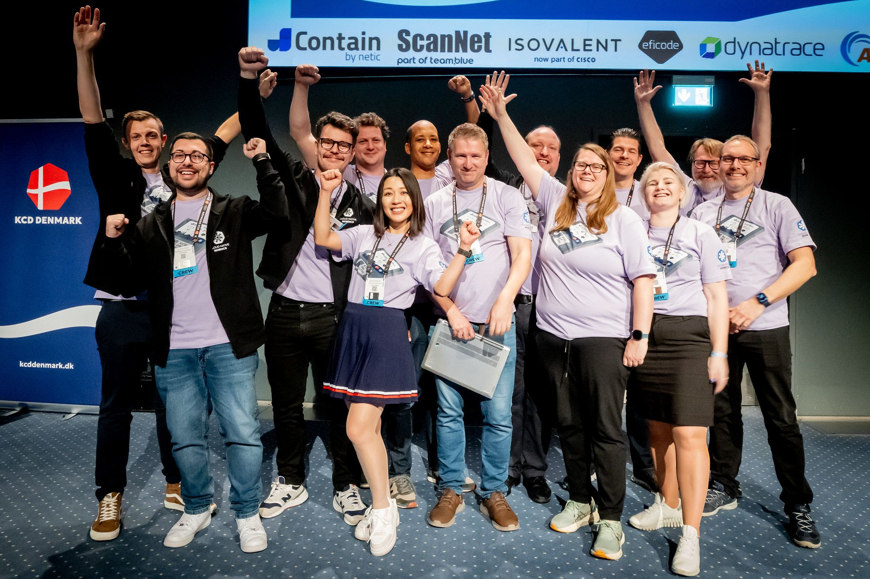

Cloud Native Community
jbrejnholt
Notes:
Encourage Saxonians to learn
Contribute to the community - org
Sharing what we learn

Slide 5

Cloud to Cloud Native
Multi-Cloud
Hybrid Cloud
Cloud Native
DR & Cost
Cloud-First
jbrejnholt
Notes:
Our cloud journey began with a 'Cloud First' strategy, where we explored the transformative benefits of cloud-native practices — embracing API-driven, modular, and scalable architectures.
As we progressed, we learned valuable lessons and invested significantly in disaster recovery and cost optimization. These efforts have paved the way for us to build a sustainable trading platform.
Click -> we are here. With a hybrid, and eventually multi-cloud approach, we aim to deliver a hosting environment that is cost-efficient, secure, and resilient — empowering our business to thrive in an increasingly dynamic digital landscape.

Slide 6



Your cloud journey?
native
jbrejnholt
Notes:
Helpful

